Slide 1
Webster Water & Sewer Departments
Annual Rate Setting Meeting
April 27, 2021
Water & Sewer Commission

Slide 2
Water Dept. Future Improvements
Project 1 – Upsize mains to 8-inch & 12-inch
Lincoln / Nelson / Whitcomb
Under Contract ~$2.10M
Project 2 – New & upsize main to 12-inch
Worcester / Old Worc. / Bigelow ~$2.45M
Project 3 – Reline & upsize main to 12-inch
School Street ~$1.88M
Project 4 – Reline & upsize main to 12-inch
Lake Street ~$1.58M

Slide 3
$2.1 M Project
$2.0 M Project
$2.5 M Project

Slide 4
Sewer Dept. Future Improvements
Project 1 – Collection System Repairs
Priority repairs, Sub-Systems 1, 10, & 3 ~$3.40M
Project 2 – Treatment Plant Upgrade
NPDES Permit Requirements ~$2.50M
Project 3 – Collection System Repairs
Sub-System 5 ~$1.80M
Project 4 – Collection System Repairs
Sub-Systems 2, 6, 7 ~$2.20M

Slide 5
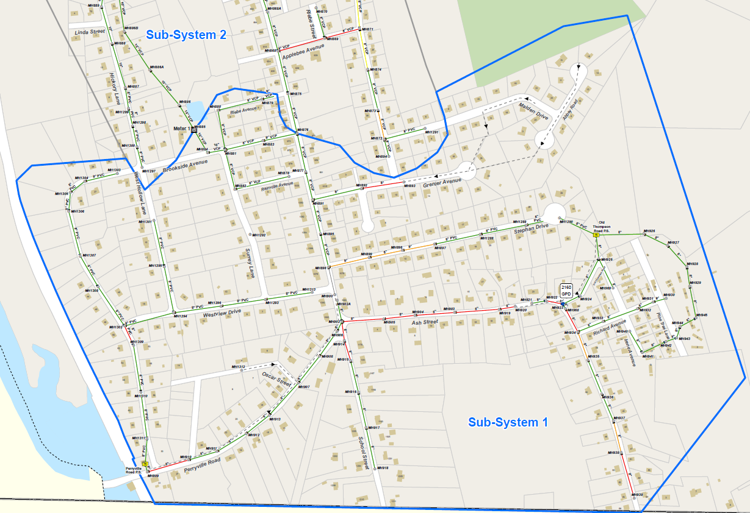
Example of Sub-System

Slide 6
$3.4 M Project
$2.2 M Project

Slide 7
New FY22 Water & Sewer Rates
Service Description | Usage (cu.ft) | Existing FY21 Rate | New FY22 Rate
Water | 0 - 500 | $32.39 | $33.37
Water | 501 - 1,000 | $64.79 | $66.73
Sewer | 0 - 500 | $44.72 | $46.06
Sewer | 501 - 1,000 | $89.44 | $92.12
Flat Rate - No Meter Sewer |  | $178.88 | $184.24
Water Senior
Water - Sr. Discount | 0 - 500 | $25.92 | $26.69
Water - Sr. Discount | 501 - 1,500 | $51.83 | $53.39
Sewer Senior
Sewer - Sr. Discount | 0 - 500 | $35.78 | $36.85
Sewer - Sr. Discount | 501 - 1,500 | $71.55 | $73.70
Flat Rate - No Meter Sewer |  | $143.1 | $147.39

